Slide 1


Lighting
2020

Slide 2
PICK-IQTM
Agenda
What is “Pick-to-Light”?
PICK-IQTM Refresh
  Advantages
  How it works
  Features
PICK-IQTM Devices and Features
PICK-IQTM Application Approaches

Slide 3
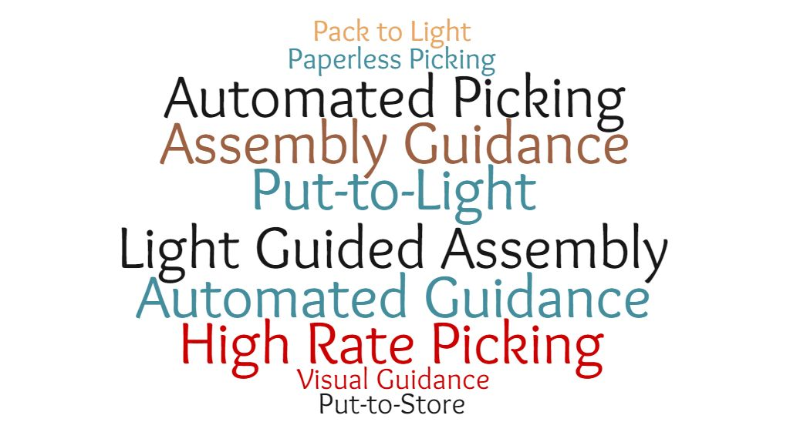
PICK-IQTM
A few alternatives to Pick-to-Light…

Slide 4









PICK-IQTM
Production Rates
Accuracy and Quality
Training Speed
Restock Time
Labor Expense

Slide 5

PICK-IQTM
How does PICK-IQ help?
Simplifies installation and implementation of a Pick-to-Light system
Reduces integration time and expense while creating a fast and adaptable system
Harnesses the power of all models of Pro with PICK-IQ™ using device-to-device connections
Features of a PICK-IQ Device and System
Faster response speed and simplified programming to Modbus RTU communication
Full access to color, flashing, rotating, and dimming settings as well as advanced animations
Facilitates many pick points while maintaining a rapid pace to exceed productivity targets

Slide 6
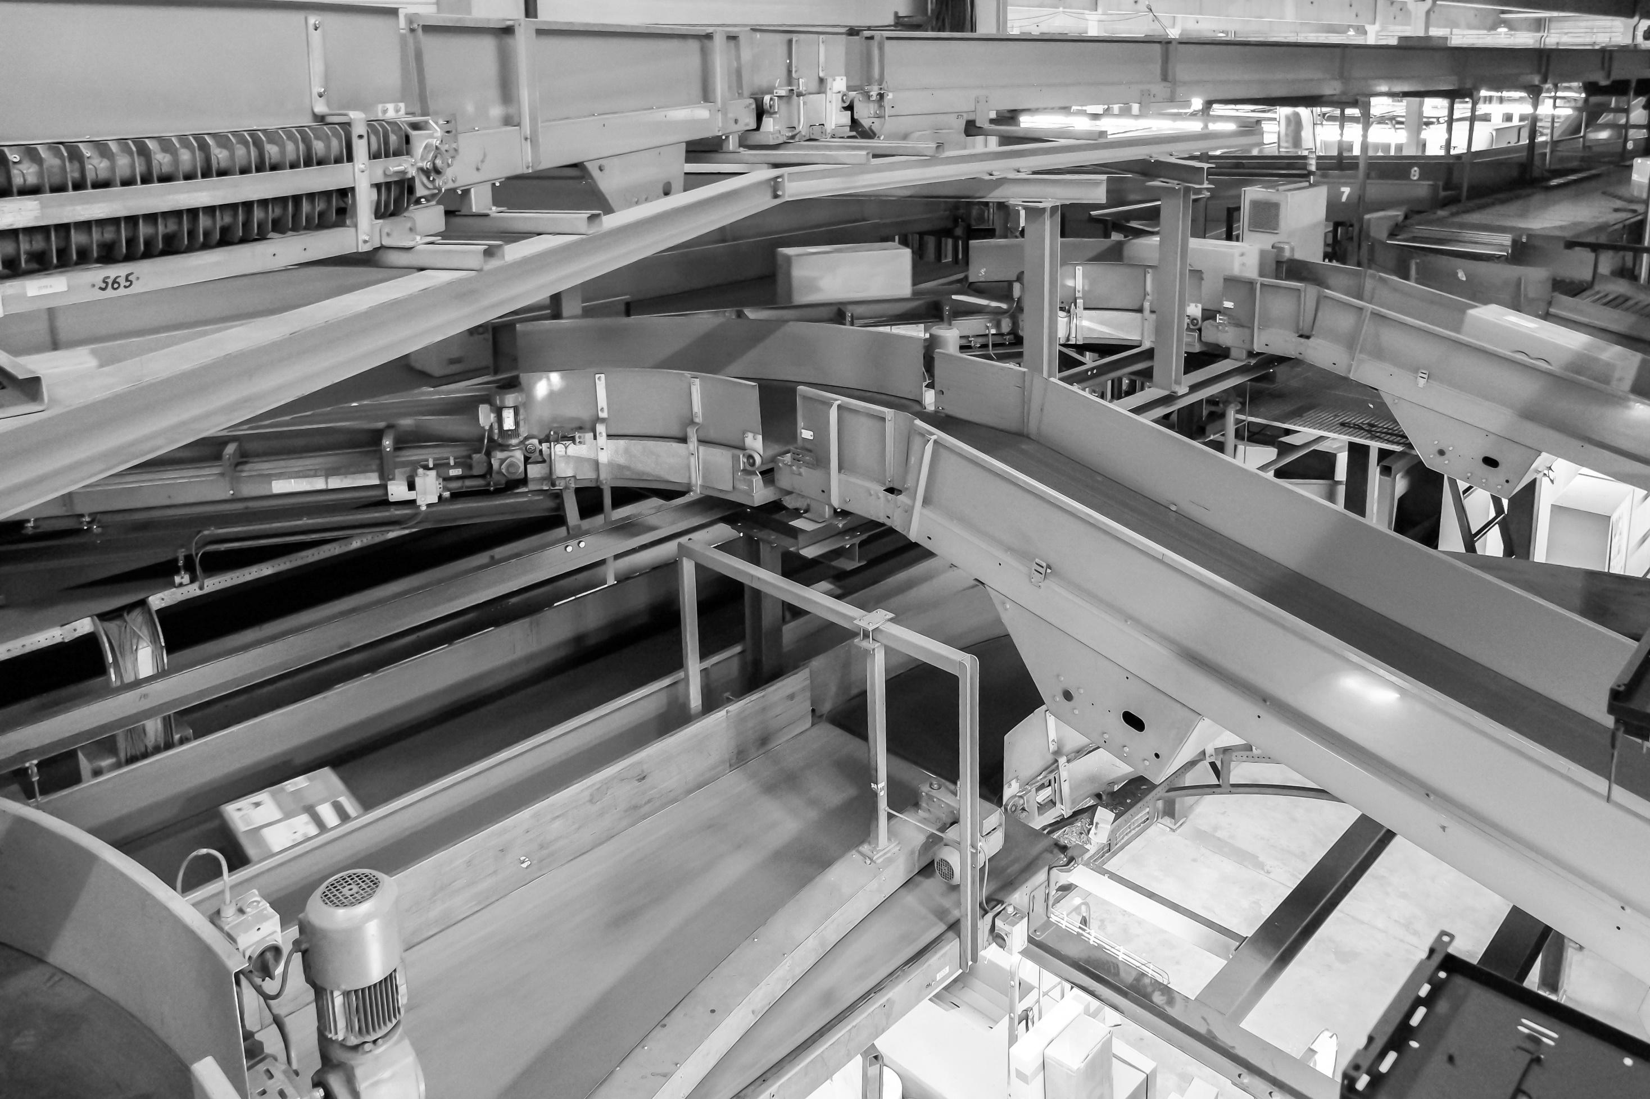
PICK-IQ™ How it Works

Slide 7
PICK-IQTM
A purpose-built, Modbus compatible serial bus protocol that uses a Common ID to reduce the typical latency that comes from polling multiple devices. The high response speed that results works well for applications that require many pick points while maintaining a rapid pace for productivity.

Slide 8
Modbus vs. PICK-IQTM
Modbus
PICK-IQ
One Master has up to 247 slaves
Each slave has ONE unique address (1-247)
Broadcast messages can be sent to all slaves
  Write only, not read
Speed is dependent on several factors – generally it is fairly fast
Based on Modbus
Each slave has TWO addresses
  Slave ID (Unique)
  Common ID (195 by default)
Common ID is the same between all devices in a system
Enables the system to find an activated device faster

Slide 9
PICK-IQTM
Each PTL has TWO addresses
  Common ID – 195 by default. This address is the same between all devices in the system
  Slave ID – This is a unique identifier for the devices in the system
Controller will poll address 195 register 7940. When a device is activated, it will respond with its unique Slave ID in this register.
Think of a teacher and a classroom….

Slide 10



PICK-IQ™
COMMON ID
SID
Ask everyone - Who responds first?
Finish first conversation, then on to the next

Slide 11
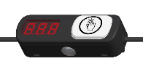
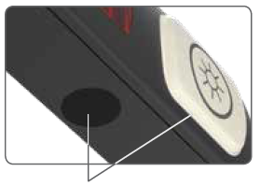
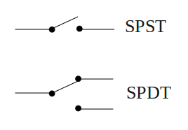
PICK-IQ™ Communication
High speed serial communication to simplify pick- and put-to-light applications
  Compatible with Modbus RS-485 master devices
  Custom firmware in the device with a “common ID”
    Each device has two IDs
    Common slave ID is shared by all devices; only the activated one responds
      Registers 7940, 7941 and 7942 are accessible
Common (195)
Slave ID

Slide 12

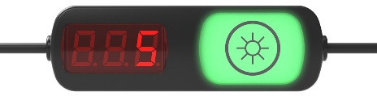
PICK-IQTM Topology
Device connected to serial master, then add additional devices in series
    1 to 246 total connected devices possible per chain
    64* or more under standard usage with a single power supply
    >200 possible depending on power supply, cable length and device usage
MASTER

Slide 13
PICK-IQTM – How to Use it?
LOCAL
Connect to Modbus master
  DXM700
Set device addresses
Set device configurations
Program ‘recipe’ or connect to manufacturing system
Update as necessary
HOST
MES
ERP
DXM
PLC
HMI
DEVICE
NETWORK

Slide 14
PICK-IQ™ Devices

Slide 15
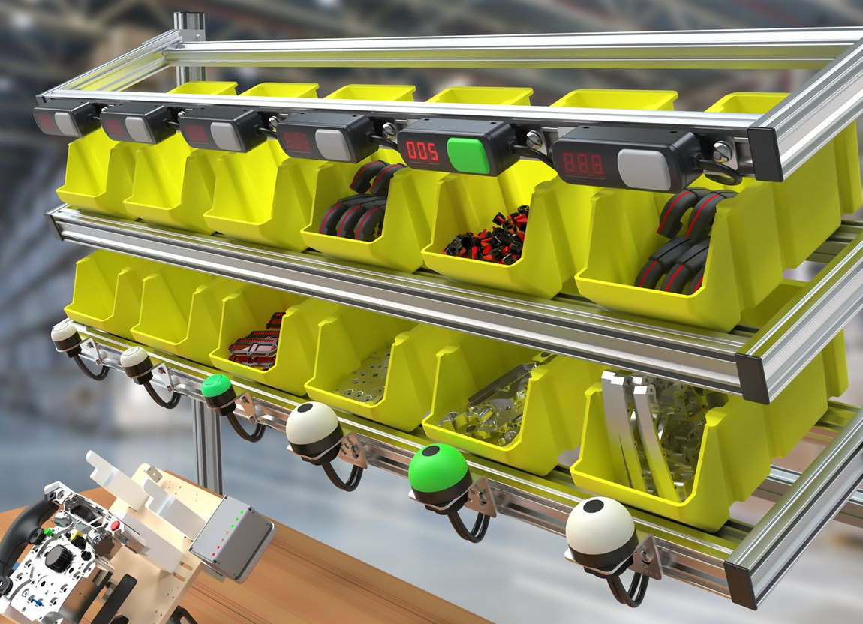
PICK-IQTM
PICK-IQTM - a technology platform
Header 2
PTL110
K50 Pro Touch
K50 Pro Optical
K50 Pro Push Button
K50 Pro Indicator
K30 Pro Touch
K30 Pro Indicator
Comparison statement
  Sub
    Sub

Slide 16
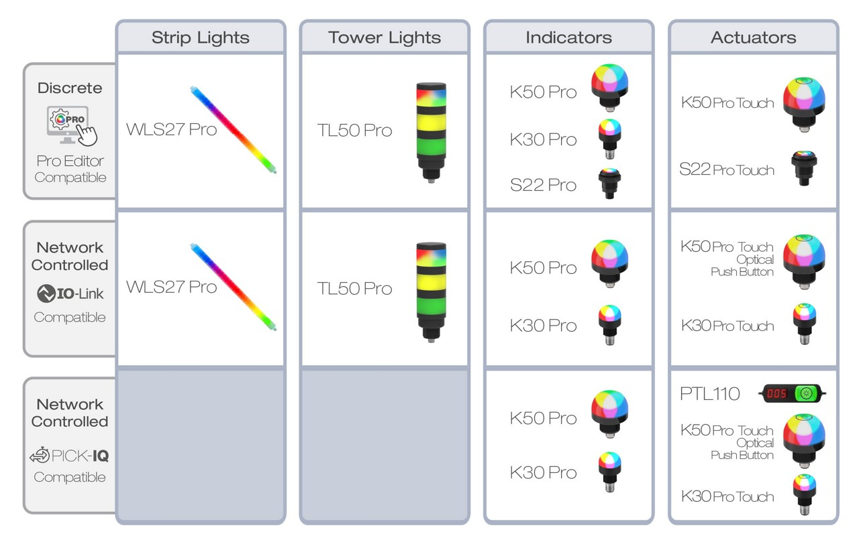
PICK-IQTM

Slide 17
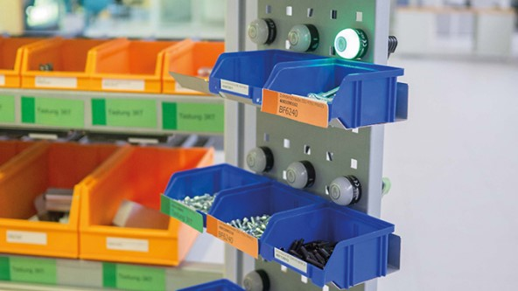
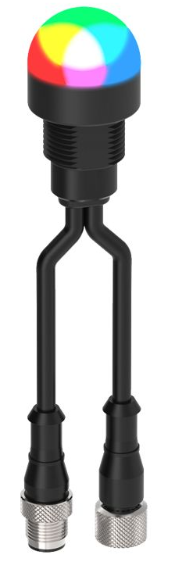
PICK-IQTM
Use K30 Pro devices for:
  Compact and small-scale picking operations requiring increased production efficiencies
  Guided indication and confirmation for intricate assemblies
Comparison statement
  Sub
    Sub

Slide 18
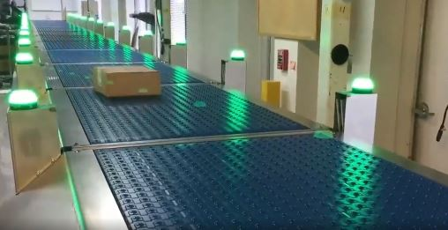
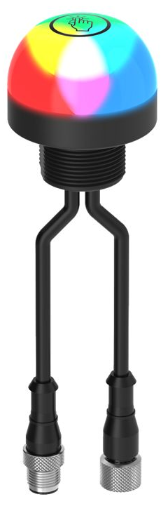
PICK-IQTM
Use K50 Devices for:
  General purpose picking or putting stations requiring simplified mounting and direct device connections
  Varied assembly processes requiring alternative confirmation methods (Sensor, Touch, Push Button)

Slide 19
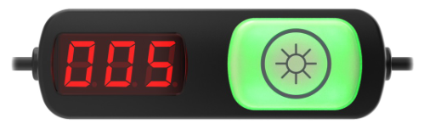
PICK-IQTM
Use PTL110 Devices for:
  Kitting areas which have numerous parts to satisfy material demand for multiple models
  Eliminating errors and ensuring quality when multiple parts are built at one station
  Ensuring accuracy when multiple parts must be selected from single locations

Slide 20
PICK-IQTM
Mix and Match
  SOLUTIONSKIT-PTL or DXM700-B1-PTL
  Varied installation setup
  Large scale applications requiring multiple form factors

Slide 21

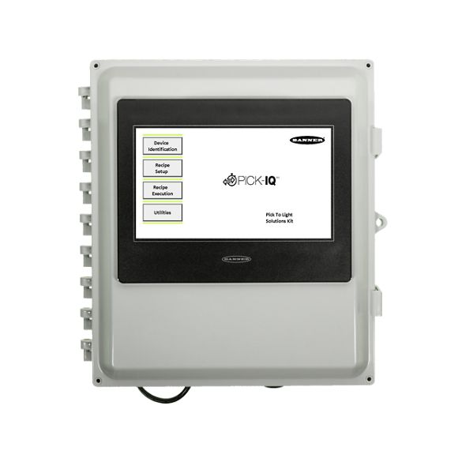
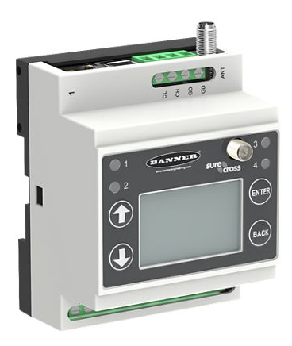

PICK-IQTM
Application Solutions
SOLUTIONSKIT-PTL
DXM700-B1-PTL
DXM700 + Integrator
Kit for fast installation
Dozens of pick points
Pre-configured XML/Script
Serial to pick devices
Ethernet to system
Pre-configured XML/scripts
Dozens to >100 pick points
Serial to pick devices
Host to system
Custom Scripts/Programs
Dozens to >100 pick points

Slide 22
PICK-IQTM
Resources
Pick-to-Light Category Page
Pick-to-Light Applications Page
PICK-IQ Overview Flyer
PTL110/PICK-IQ Technical Webinar
PTL110/PICK-IQ Launch PowerPoint – includes in-depth PICK-IQ information

